Slide 1
Testing & Evaluation
Milestone 5 done by: Mehraeel Philip, Fatema Milad, Sama Gehad, Marwan Ahmed, Mo’men Mohie & Jana Mahdy

Slide 2
Background Summary
Traditional audition evaluation relies heavily on subjective human judgment, which may vary depending on the di rector’s experience, fatigue, and personal bias. This introduces inconsistency when assessing large volumes of candidates within limited timeframes. To address this challenge, this work formulates audition analysis as a Multi-Modal Hu man Activity Recognition (HAR) problem, where visual, vocal, and behavioral cues are analyzed simultaneously to pro duce objective performance metrics.

Slide 3
TESTING STRATEGY
01
System & Integration Testing
02
User Acceptance Testing
03
Field Study
04
System Performance Testing
full pipeline (upload → analysis → report)
user acceptance evaluated by directors / users
full pipeline (upload → analysis → report)
evaluating how the system perform

Slide 4
A. Functional Cases
A1. Video Input
TEST ID | TEST CASE | STEPS | EXPECTED RESULT
TC-01 | File upload | Choose file | Accepts browsing
TC-02 | Frame Capture | Run system | Frames processed continuously
TC-03 | Invalid file type | Wrong fie input | Error handled gracefully
TC-04 | File ready to be processed | Start analysis | Load report

Slide 5
A. Functional Cases
A2. Emotion Detection
TEST ID | TEST CASE | EXPECTED RESULT
TC-05 | Happy face | "Happy" detected
TC-06 | Sad acting | "Sad" detected
TC-07 | Neutral | Neutral detected
TC-08 | Lighting change | Still detects correctly

Slide 6
A. Functional Cases
A3. Face and Eye Tracking
TEST ID | TEST CASE | EXPECTED RESULT
TC-09 | No face | No crash, no detection
TC-10 | Eye Tracking | Eye scoring and analysis
TC-11 | No voice | No crash, no detection
TC-12 | Multiple faces | Only one face tracked

Slide 7
A. Functional Cases
A4. Gesture Recognition
TEST ID | TEST CASE | EXPECTED RESULT
TC-13 | Known gesture | Correct classification
TC-14 | Unknown gesture | Rejected or low confidence
TC-15 | Speed variation | Still recognized
TC-16 | Noise input | No false positives

Slide 8
A. Functional Cases
A5. Action Segmentation
TEST ID | TEST CASE | EXPECTED RESULT
TC-17 | Multiple actions | All actions segmented
TC-18 | Overlapping actions | Correct boundaries
TC-19 | Speed variation | Still recognized
TC-20 | Missing frames | Robust handling, scoring

Slide 9
A6. Report Generation
TEST ID | TEST CASE | EXPECTED RESULT
TC-21 | Generate report | Output created
TC-22 | Printing report | Printed locally
TC-23 | Score display | Numeric scores shown
TC-24 | Performance classification | Good, Moderate or Bad shown
TC-25 | Visualization | Widgets render
TC-26 | New analysis restart | Button accessible
TC-27 | Variables Classification | Independent variable scoring
TC-28 | Recommendations | Improvement advices

Slide 10
B. Non-Functional Cases
B1. Performance Testing
TEST ID | TEST CASE | EXPECTED RESULT
TC-29 | FPS (real-time) | ≥ 15 FPS
TC-30 | Processing delay | < 200 ms
TC-31 | CPU usage | < 80%
TC-32 | Memory usage | Stable

Slide 11
B. Non-Functional Cases
B2. Usability Testing
TEST ID | TEST CASE | EXPECTED RESULT
TC-33 | First-time user | Can run without help
TC-34 | UI clarity | Buttons understandable
TC-35 | Report readability | Easy to interpret
TC-36 | Error messages | Clear

Slide 12
B. Non-Functional Cases
B3. Security Testing
TEST ID | TEST CASE | EXPECTED RESULT
TC-37 | Invalid file upload | Rejected
TC-38 | Large file | Handled safely
TC-39 | Data privacy | No external leaks
TC-40 | Path injection | Prevented

Slide 13
B. Non-Functional Cases
B4. Reliability Testing
TEST ID | TEST CASE | EXPECTED RESULT
TC-40 | Multiple runs | Stable
TC-41 | Restart system (Recovery) | Works again
TC-42 | Load testing | Expected user loads processed
TC-43 | Feature testing | Individual functions working
TC-44 | Endurance testing | Stable
TC-45 | Mean Time To Repair | < 1s

Slide 14
02
USABILITY TESTING
Evaluate how well directors interact with the system

Slide 15
Testing Plan
Measure:
Time to complete tasks
Number of errors
Task success rate
Participants: 5–10 users
User satisfaction

Slide 16
Metrics to Test Usability
Metric | Description | Results
Task Completion Rate | % of users completed task | 100 %
Time to Complete | Minutes | ~ 3 minutes
Error Count | Number of mistakes | 2 mistakes
User Satisfaction | Questionnaire | ~ score: 85
Use SUS (System Usability Scale)
Score range: 0–100
Passing score: ≥ 68
Example of feedbacks:
“The system was easy to use”
“I felt confident using the system”

Slide 17
03
FIELD STUDY (REAL ENVIRONMENT TEST)
Evaluate system in real acting scenario

Slide 18
Strategy
Implementation
Data Collection
Example Findings
Record actors performing scenes naturally.
Use the system for real auditions
Observations – Interviews - Video recordings - User feedback
Lighting affects emotion detection
Actor feels stressed = gaze instability

Slide 19
04
System Performance Testing
Evaluate system in as of performance

Slide 20
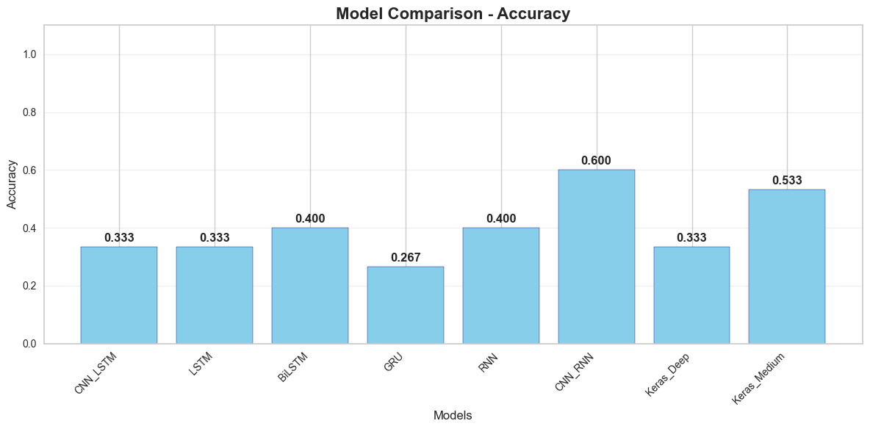
Accuracy Comparison

Slide 21
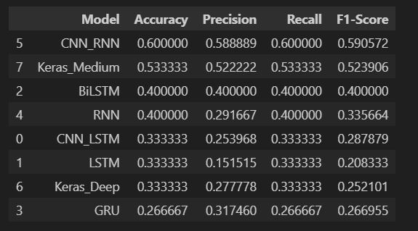
Evaluation Metrics Table

Slide 22
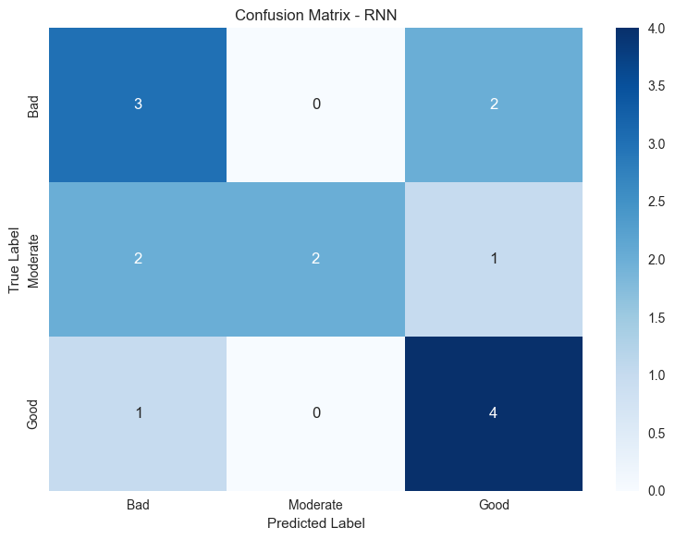
Confusion Matrix

Slide 24
OUR TEACHING METHOD
ACTIVITIES
Saturn is a gas giant and has several rings
GOALS
FEEDBACK
Jupiter is the biggest planet of them all
Mercury is the closest planet to the Sun

Slide 25
THE CURRICULUM
INTRODUCTION
Mercury is the closest planet to the Sun and the smallest one in System
2XXX | Jupiter is a big planet
2XXX | Earth is where all live
2XXX | Mars is a cold place
2XXX | Saturn has several rings
ADVANTAGES
75%
80%
95%
EARTH
VENUS
SATURN
FEATURES
55%
NEPTUNE
75%
MERCURY

Slide 26
OUR ACADEMIC AREAS
MERCURY
VENUS
JUPITER
MARS
SATURN
EARTH
Mercury is the closest planet to the Sun
Venus is the second planet from the Sun
Jupiter is the biggest planet of them all
Despite being red, Mars is a cold place
Saturn is a gas giant and has several rings
Earth is the only planet that harbors life

Slide 27
MISSION AND VISION
MISSION
VISION
Saturn is composed mostly of hydrogen and helium. It was named after the Roman god of wealth and agriculture
Venus has a beautiful name and is the second planet from the Sun. It’s terribly hot, even hotter than Mercury

Slide 28
OUR VALUES
SATURN
EARTH
JUPITER
VENUS
Saturn is a gas giant and has several rings
Earth is the only planet that harbors life
Jupiter is the biggest planet of them all
Venus is the second planet from the Sun

Slide 29
OUR SUCCESS
MERCURY
JUPITER
75%
90%
VENUS
SATURN
85%
95%
Mercury is the closest planet to the Sun
Jupiter is the biggest planet of them all
Venus is the second planet from the Sun
Saturn is a gas giant and has several rings

Slide 30

A PICTURE REINFORCES THE CONCEPT
Images reveal large amounts of data, so remember: use an image instead of a long text. Your audience will appreciate it

Slide 31
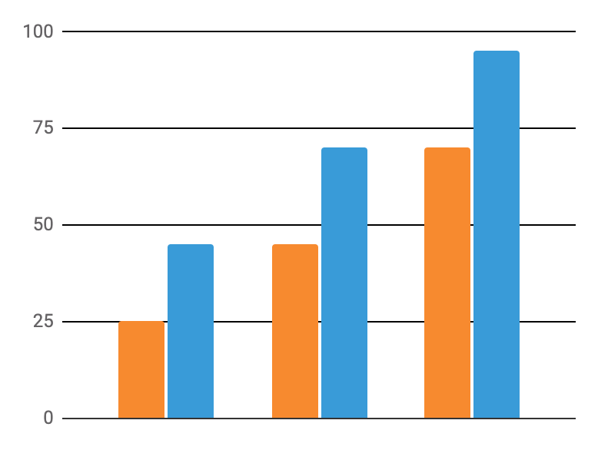
STATISTICS
VENUS
Venus is the second planet from the Sun
MARS
Despite being red, Mars is a cold place
Follow the link in the graph to modify its data and then paste the new one here. For more info, click here

Slide 32


OUR TEACHERS
JENNA DOE
TIMMY JIMMY
You can speak a bit about this person here
You can speak a bit about this person here

Slide 33
OUR GOALS
2XXX
SATURN
Saturn is a gas giant and has several rings
2XXX
VENUS
Venus is the second planet from the Sun
2XXX
JUPITER
Jupiter is the biggest planet of them all

Slide 34
STUDENT PROGRESS
1ST TERM
3RD TERM
Saturn is a gas giant and has several rings
Earth is the only planet that harbors life
2ND TERM
4TH TERM
Jupiter is the biggest planet of them all
Venus is the second planet from the Sun

Slide 35
ENROLLMENT PROCESS
STEP 1
Saturn is a gas giant and has several rings
STEP 2
Venus is the second planet from the Sun
STEP 3
Jupiter is the biggest planet of them all

Slide 36
SPECIAL REMINDERS
Mercury is the closest planet to the Sun and the smallest one in the Solar System
Mars is a cold place. It's full of iron oxide dust, which gives the planet its reddish cast
Saturn is a gas giant and has several rings. It's composed mostly of hydrogen and helium
Earth is the third planet from the Sun and the only one that harbors life in the Solar System
Venus is terribly hot, even hotter than Mercury, and its atmosphere is extremely poisonous

